Slide 1
Analyzing Parole Violations
ST635 Group 1: Ethan Clabaugh, Jaime Fastino,
Cayty Fitzgerald, Nicole Romangsuriat, Jessica Smith

Slide 2
Agenda
Dataset
Findings
Research Questions
Methodology
01
04
02
05
Model Comparisons
03
06
Conclusion

Slide 3
Dataset
Kaggle <- US 2004 National Corrections Reporting Program
Nationwide census of parole releases in 2004
Only paroles serving <= 6 months
Only parolees whose max sentence <= 18 months
Response: parole violation (yes/no)
Predictors: 5 categorical, 3 quantitative
675 data values

Slide 4

Research Questions
Which individual predictor has the greatest impact on parole violations?
Which combination of variables are most predictive of a parole violation?
Can we create a model that accurately predicts parole violations?

Slide 5

Methodology

Slide 6
Understanding & Cleaning Data
Exploratory Data Analysis (no. of values, missing values, variable types)
Summary Statistics
Mean Data

Slide 7

Logistic Regression
Ridge &
LASSO
Divide data into training/testing sets
Fit two logistic regression models
Observed lambda values
Fit model with all predictors
Compare p-values
Revise the model

Slide 8
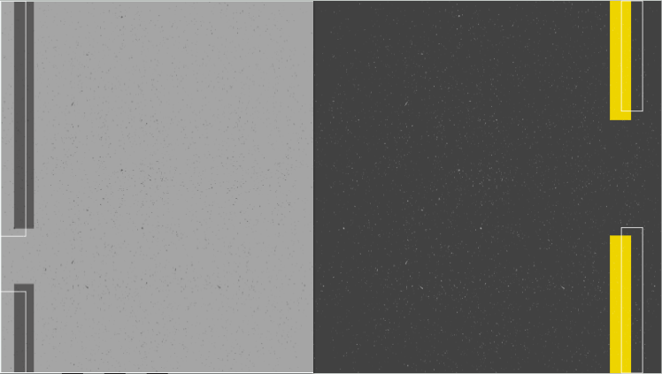
PCA
Classification
Tree
Find predictors, group with R
Choose PCs (Scree Plot, 80-90% Rule)
Fit linear regression
Split into training/testing data
Build full tree with CP = 0
Prune tree - prevent overfitting
Look at xerror in CP tables, pick smallest values

Slide 9
Model Comparisons
Model Utility (AUC)
Goodness of Fit & Model Assumptions
Accuracy (Confusion Matrix & R²)

Slide 10

Findings

Slide 11
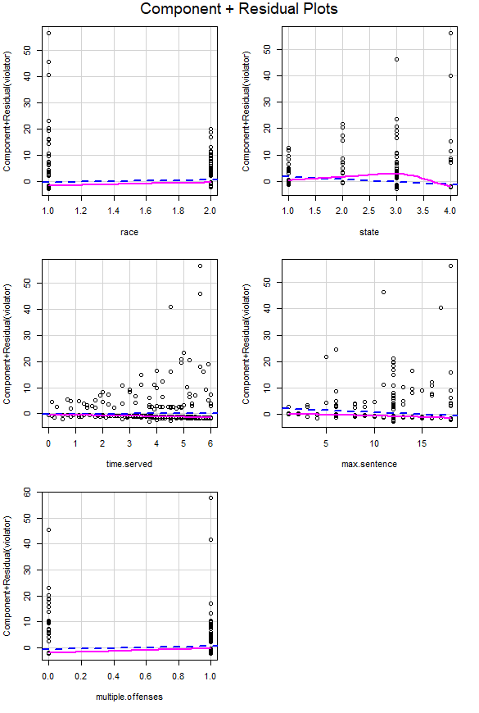
Logistic Regression
AUC: 0.767 > 0.5 -> good utility
Likelihood Ratio: near 0 -> goodness-of-fit
Straight residuals -> linearity
VIF close to 1 -> no multicollinearity
88.3% confusion matrix accuracy
0.99 sensitivity, 0.06 specificity

Slide 12
Ridge & LASSO
AUC 0.6909 and 0.6959 > 0.5 -> good utility
^ Similar -> No severe overfitting/multicollinearity
^^ Lower than logistic regression -> penalization not useful
Lambda values close to 0 -> optimization regulation has little impact

Slide 13
PCA
PC1 had highest sd value
PC1 had highest proportion of variance
1st 5 PCs had cumulative proportion of 81%
Adjusted R²: 0.7267 -> accurate

Slide 14
Classification Tree
Pruned Tree
AUC: 0.799 -> good utility
Confusion Matrix accuracy: 87.68% -> accurate model
Full Tree
AUC: 0.758, accuracy: 85.22%
Pruned tree has the optimal model

Slide 15
Model Comparison
 | Logistic Regression | Ridge & LASSO | PCA | Decision Tree
AUC Values | 0.696 | 0.767 | - | 0.799
Accuracy (CM, Adjusted R^2) | 88.3% | 88.8% | 0.727 | 87.7%

Slide 16
Answers to RQs
Best Overall Model:
Classification Tree
Most Predictive Variable Combo:
age, multiple offenses, race, state
PCA - group variables
Other 3 - binary models
Most Impactful Predictor:
multiple offenses
3 models can accurately predict violations
Mean of 4 predictors -> 0.71 probability of not violating

Slide 17
Thank you!
Questions are welcome.

